Slide 1
Course : Calculus I
Effective Period : 2023
LIMITS Session 1-3

Slide 2

These slides have been adapted from: Stewart, J. D. Clegg, S. Watson (2020). Calculus Early Transcendentals, 9, USA, Cengage Learning, Inc, 2020. ISBN: 978-1337613927
Acknowledgement

Slide 3

Learning Objectives
LO 1:
Define the properties of limit to describe geometric and physical problems, and other applications.

Slide 4
Content
1
The Tangent and Velocity Problems
2
The Limit Function
3
Calculating Limits Using the Limit Laws
4
The Precise Definition of a Limit
5
Continuity
6
Limits at Infinity; Horizontal Asymptotes

Slide 5
The Tangent Problem
The word tangent is derived from the Latin word tangens, which means “touching.” A tangent to a curve as a line that touches the curve and follows the same direction as the curve at the point of contact.
For a circle we could simply follow Euclid and say that a tangent is a line that intersects the circle once and only once, as in Figure.
Figure shows a line that appears to be a tangent to the curve C at point P, but it intersects C twice.

Slide 6
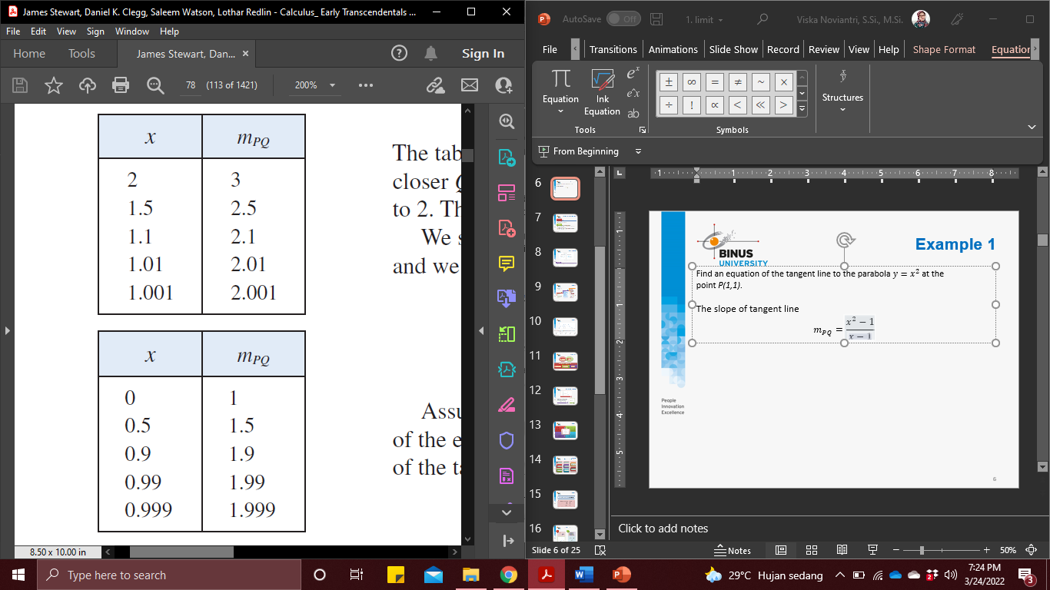

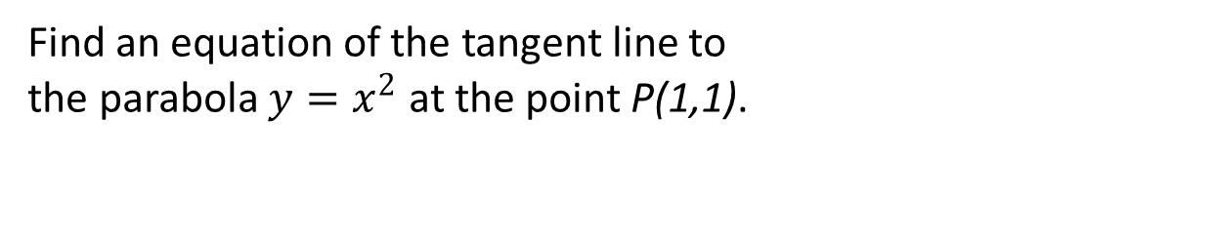
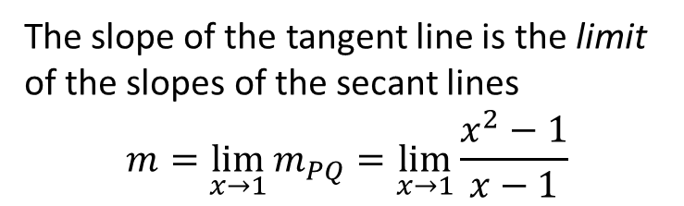
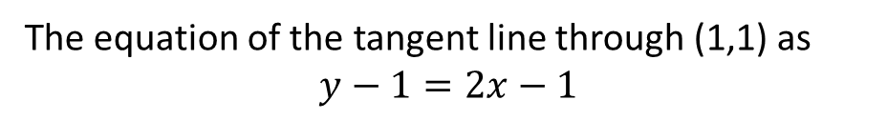
Example 1 (1/2)
Find an equation of the tangent line to
the parabola $y=x^{2}$ at the point P(1,1).
Choose $x≠1$ so that $Q≠P$. Then
$m_{PQ}=\frac{x^{2}−1}{x−1}$
The slope of the tangent line is the limit of the slopes of the secant lines
$$m=\lim_{x→1}{m_{PQ}}=\lim_{x→1}{\frac{x^{2}−1}{x−1}}$$
The equation of the tangent line through (1,1) as
$$y−1=2x−1$$

Slide 7
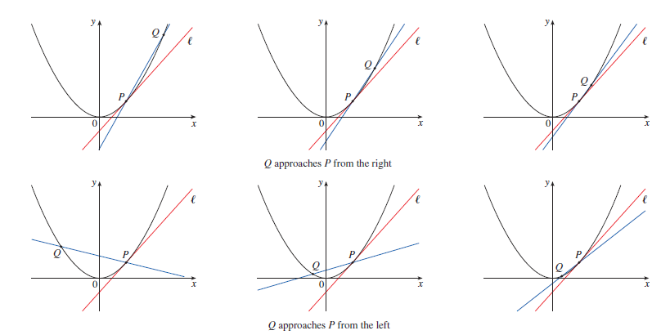
Example 1 (2/2)
As Q approaches P along the parabola, the corresponding secant lines rotate about P and approach the tangent line .

Slide 8
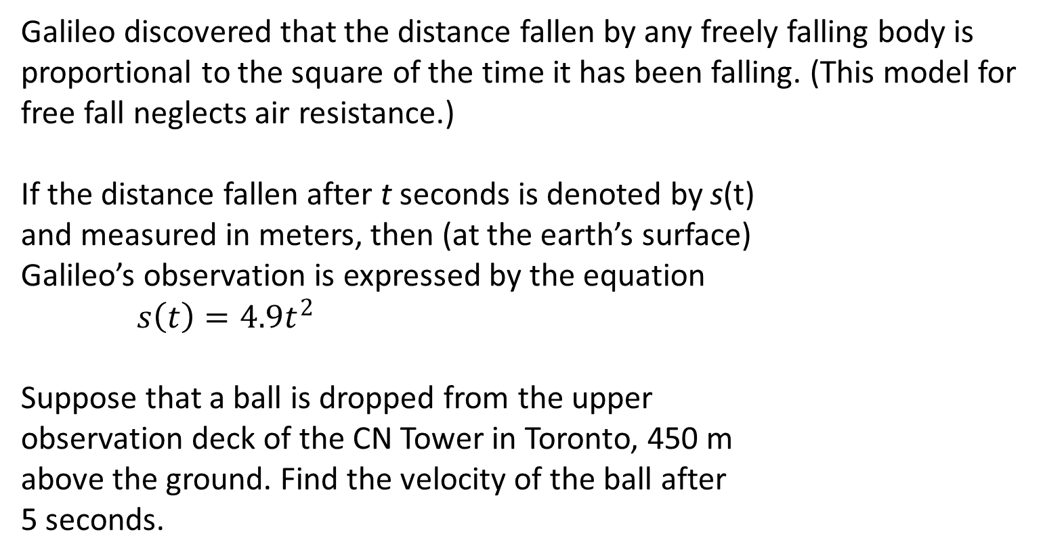
Example 2: The Velocity Problem (1/2)
Galileo discovered that the distance fallen by any freely falling body is proportional to the square of the time it has been falling. (This model for free fall neglects air resistance.)
If the distance fallen after t seconds is denoted by s(t)
and measured in meters, then (at the earth’s surface)
Galileo’s observation is expressed by the equation
$s\left(t\right)=4.9t^{2}$
Suppose that a ball is dropped from the upper
observation deck of the CN Tower in Toronto, 450 m
above the ground. Find the velocity of the ball after
5 seconds.

Slide 9
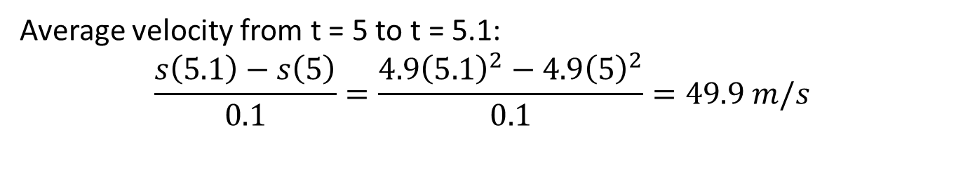
Example 2: The Velocity Problem (1/2)
Average velocity from t = 5 to t = 5.1:
$$\frac{s\left(5.1\right)−s\left(5\right)}{0.1}=\frac{4.9{\left(5.1\right)}^{2}−4.9{\left(5\right)}^{2}}{0.1}=49.9 m/s$$
The instantaneous velocity when t − 5 is defined to be the limiting value of these average velocities over shorter and shorter time periods that start at t − 5.
It appears that the (instantaneous) velocity after 5 seconds is 49 m/s.

Slide 10
Finding Limits Numerically and Graphically

Slide 11
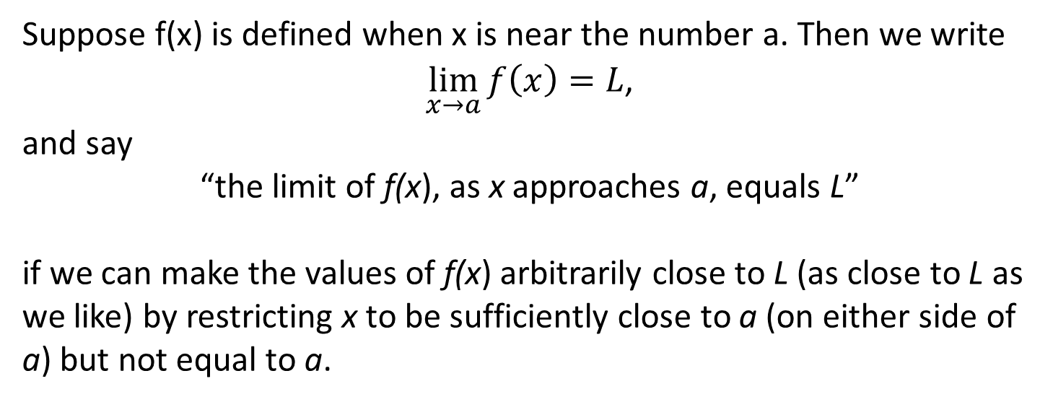
Intuitive Definition of a Limit
Limit
Definition
Suppose f(x) is defined when x is near the number a. Then we write
$\lim_{x→a}{f\left(x\right)}=L$,
and say
“the limit of f(x), as x approaches a, equals L”
if we can make the values of f(x) arbitrarily close to L (as close to L as we like) by restricting x to be sufficiently close to a (on either side of a) but not equal to a.

Slide 12
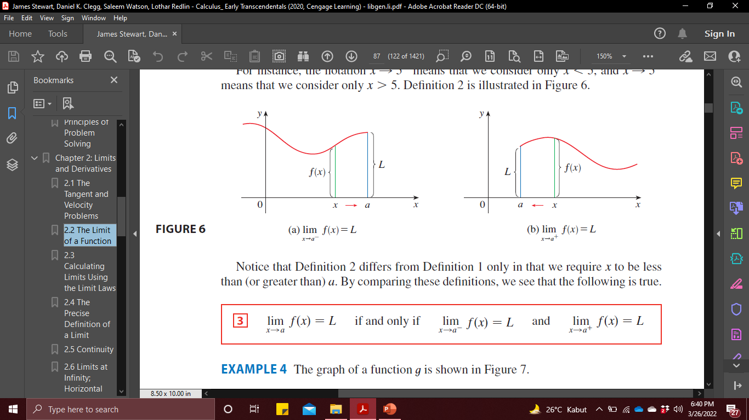
Intuitive Definition of One-Sided Limits

Slide 13
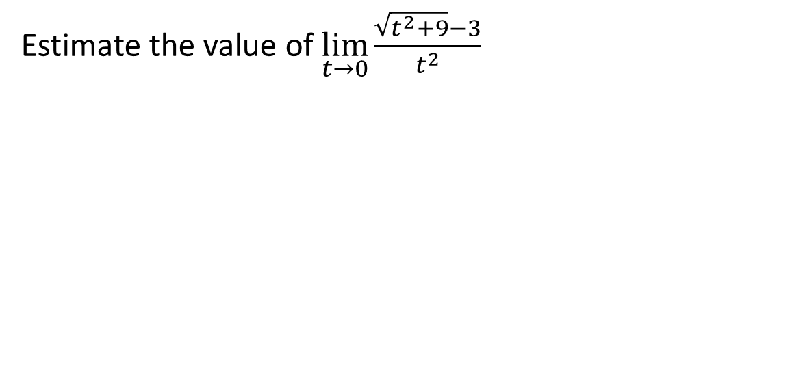
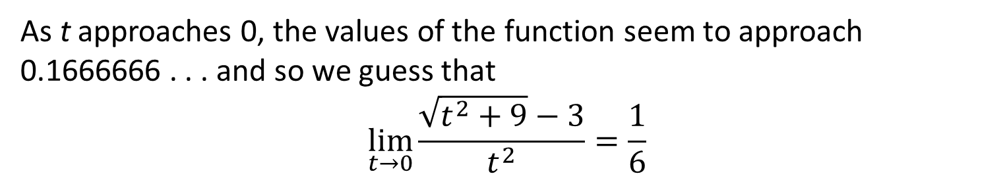
Example 3
Estimate the value of $\lim_{t→0}{\frac{\sqrt{t^{2}+9}−3}{t^{2}}}$
As t approaches 0, the values of the function seem to approach 0.1666666 . . . and so we guess that
$$\lim_{t→0}{\frac{\sqrt{t^{2}+9}−3}{t^{2}}}=\frac{1}{6}$$

Slide 14
Let’s Check It Out
The graph of a function t is shown in Figure.
Use the graph to state the values (if they exist) of the following

Slide 15
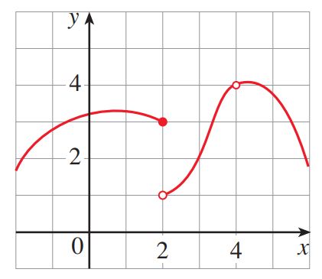
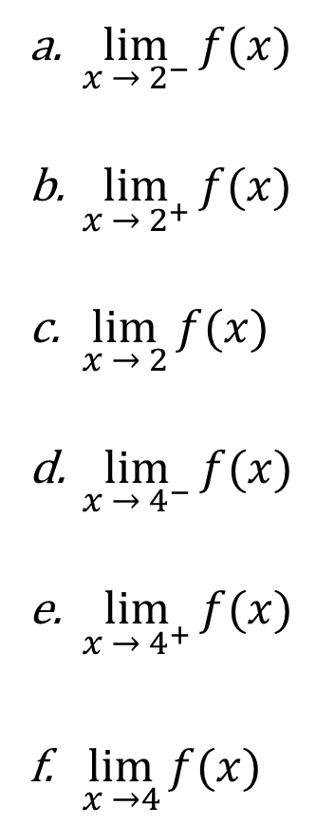
$\lim_{x →{ 2}^{−}}{f(x)}$
$\lim_{x → 2^{+}}{f(x)}$
$\lim_{x → 2}{f(x)}$
$\lim_{x →{ 4}^{−}}{f(x)}$
$\lim_{x → 4^{+}}{f(x)}$
$\lim_{x →4}{f(x)}$

Slide 16
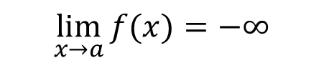

Infinite Limit
Let f be a function defined on both sides of a, except possibly at a itself.
$$\lim_{x→a}{f(x)}=∞$$
$$\lim_{x→a}{f(x)}=−∞$$
means that the values of f(x) can be made arbitrarily large (as large as we please) by taking x sufficiently close to a, but not equal to a.
means that the values of f(x) can be made arbitrarily large negative by taking x sufficiently close to a, but not equal to a.

Slide 17

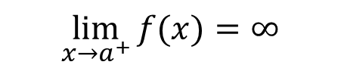


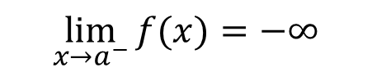
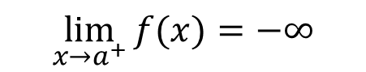
Vertical Asymptotes
The vertical line x − a is called a vertical asymptote of the
curve y = f (x) if at least one of the following statements is true:
$$\lim_{x→a}{f(x)}=∞$$
$$\lim_{x→a^{+}}{f(x)}=∞$$
$$\lim_{x→a^{−}}{f(x)}=∞$$
$$\lim_{x→a}{f(x)}=−∞$$
$$\lim_{x→a^{+}}{f(x)}=−∞$$
$$\lim_{x→a^{−}}{f(x)}=−∞$$

Slide 18

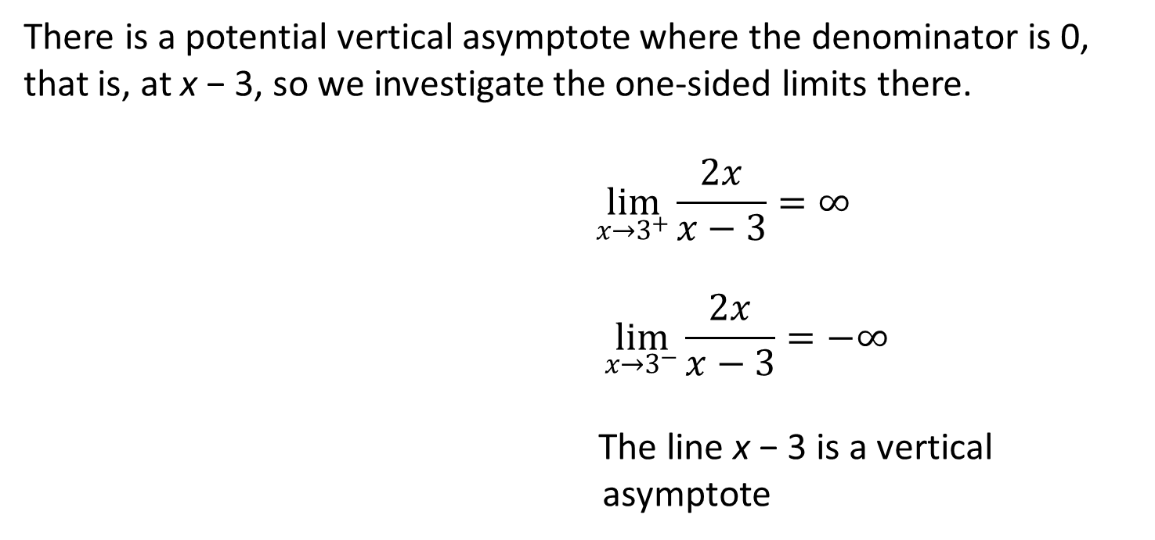
Example 4
Let the curve $y=\frac{2x}{x−3}$ is given in Figure.
There is a potential vertical asymptote where the denominator is 0, that is, at x − 3, so we investigate the one-sided limits there.
$$\lim_{x→3^{+}}{\frac{2x}{x−3}}=∞$$
$$\lim_{x→3^{−}}{\frac{2x}{x−3}}=−∞$$
The line x − 3 is a vertical
asymptote

Slide 19
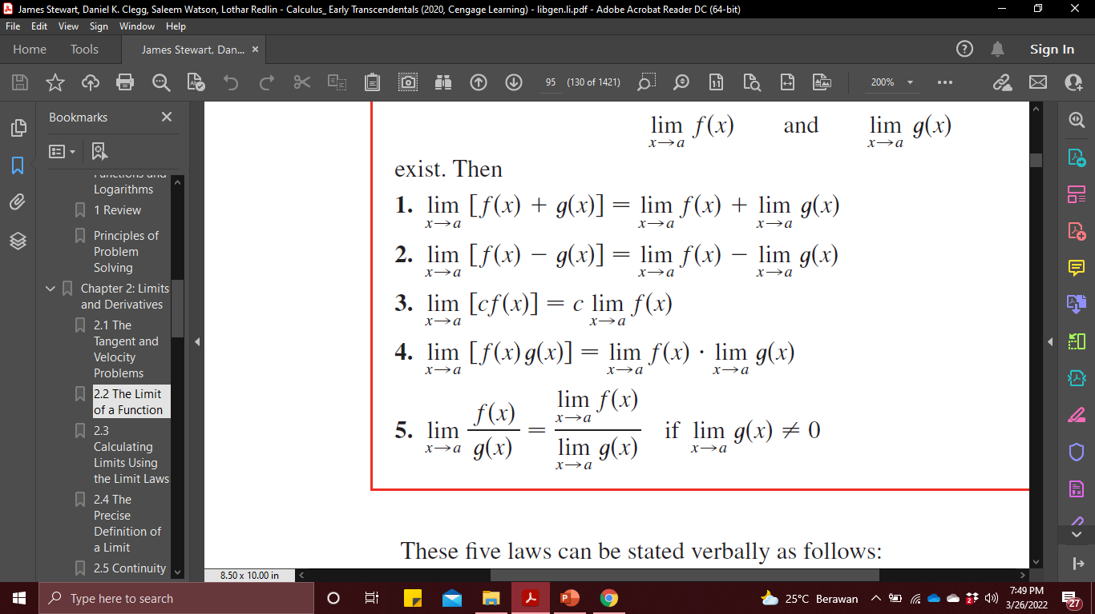
Limit Laws (1/2)
Suppose that c is a constant and the limits$\lim_{x→a}{f\left(x\right)}$ and $\lim_{x→a}{g\left(x\right)}$ exist.

Slide 20
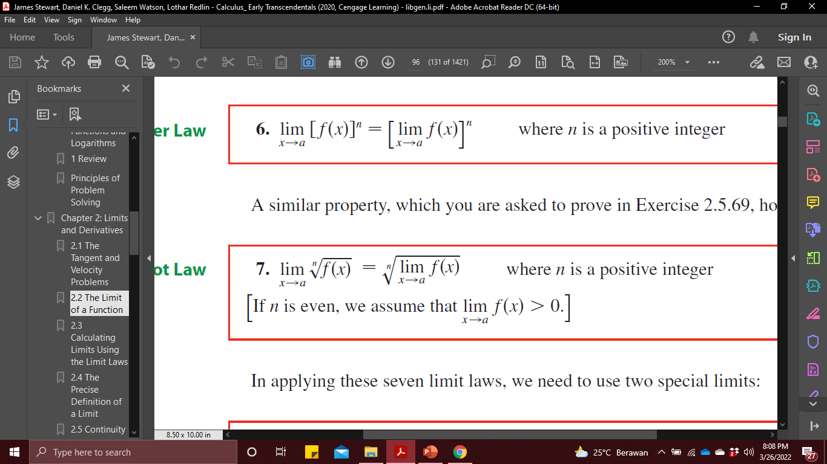
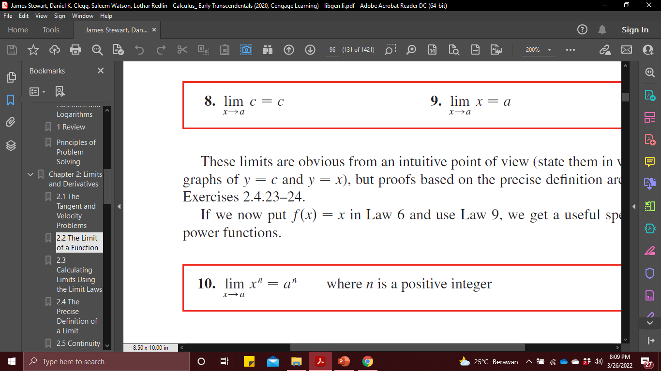
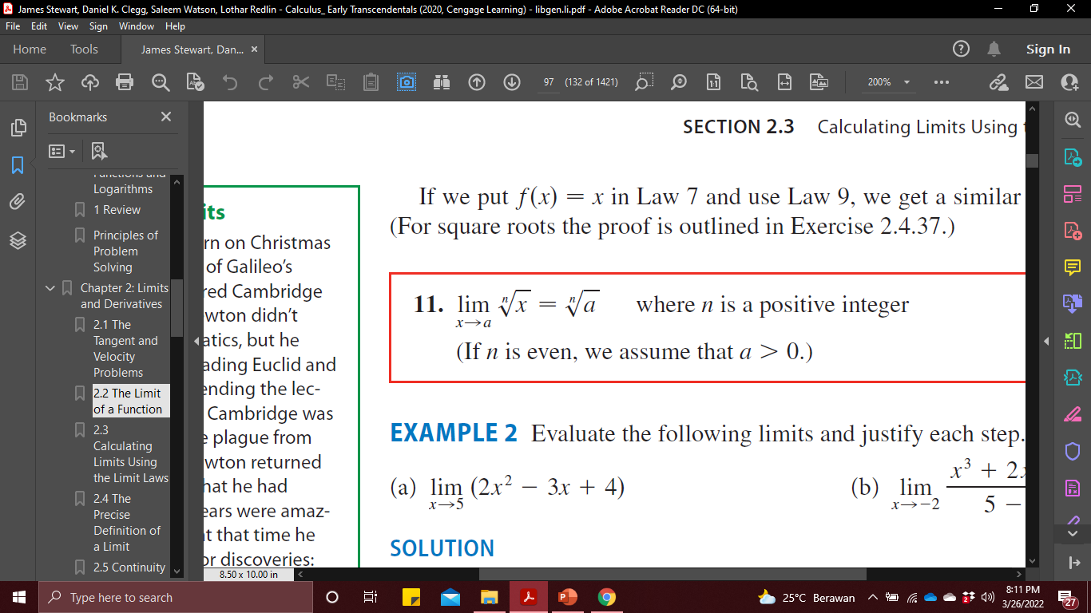
Limit Laws (2/2)

Slide 21
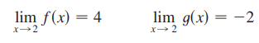
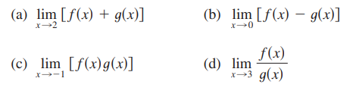
2
2
2

Slide 22
Example 5
See the graphs of f and g in Figure

Slide 23
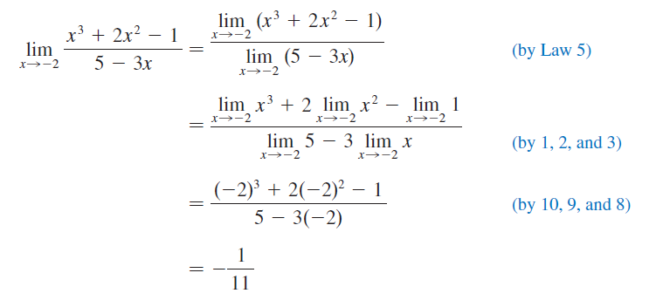
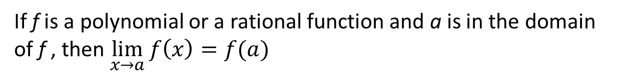
Direct Substitution Property
Property
If f is a polynomial or a rational function and a is in the domain of f , then $\lim_{x→a}{f\left(x\right)=f(a)}$
Example

Slide 24
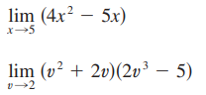
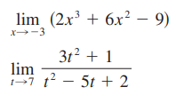
a.
b.
c.
d.

Slide 25
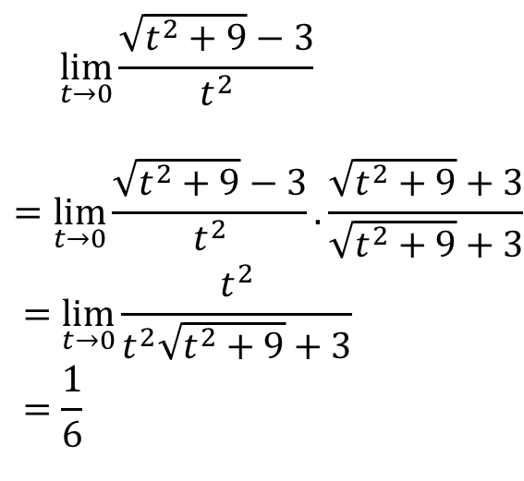
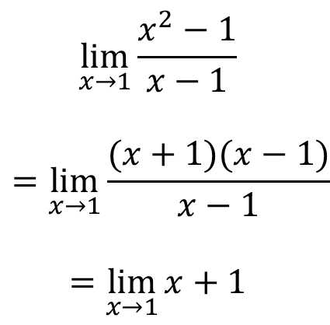
Example 6: Limit by Preliminary Algebra
1
2
$$\lim_{x→1}{\frac{x^{2}−1}{x−1}}$$
$$=\lim_{x→1}{\frac{(x+1)(x−1)}{x−1}}$$
$$=\lim_{x→1}{x+1}$$
$$\lim_{t→0}{\frac{\sqrt{t^{2}+9}−3}{t^{2}}}$$
$$=\lim_{t→0}{\frac{\sqrt{t^{2}+9}−3}{t^{2}}}.\frac{\sqrt{t^{2}+9}+3}{\sqrt{t^{2}+9}+3}$$
$$=\lim_{t→0}{\frac{t^{2}}{t^{2}\sqrt{t^{2}+9}+3}}=\frac{1}{6}$$

Slide 26
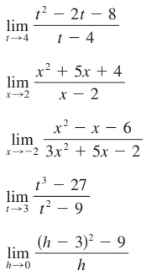
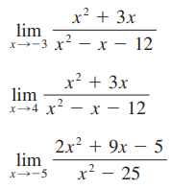
a.
e.
b.
f.
c.
g.
d.

Slide 27
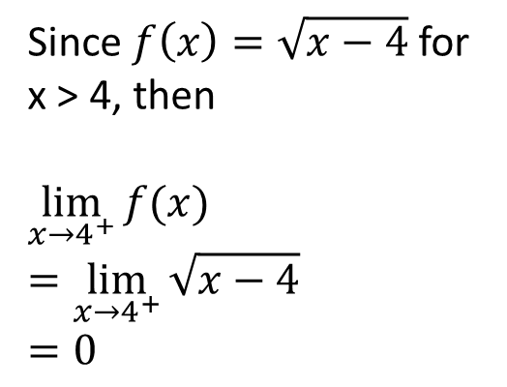

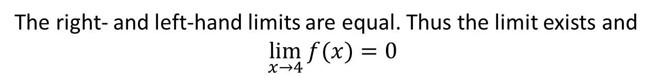
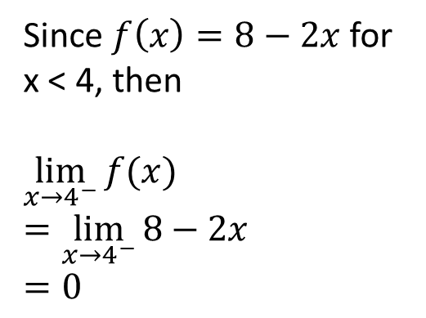
Example 7
Let $f\left(x\right)=\left\{\begin{matrix}\sqrt{x−4}, if x>4 \\ 8−2x, if x<4\end{matrix}\right.$
Since $f\left(x\right)=\sqrt{x−4}$ for x > 4, then
$$\lim_{x→4^{+}}{f(x)}$$
$$=\lim_{x→4^{+}}{\sqrt{x−4}}$$
$$=0$$
Since $f\left(x\right)=8−2x$ for x < 4, then
$$\lim_{x→4^{−}}{f(x)}$$
$$=\lim_{x→4^{−}}{8−2x}$$
$$=0$$
The right- and left-hand limits are equal. Thus the limit exists and
$$\lim_{x→4}{f(x)}=0$$

Slide 28
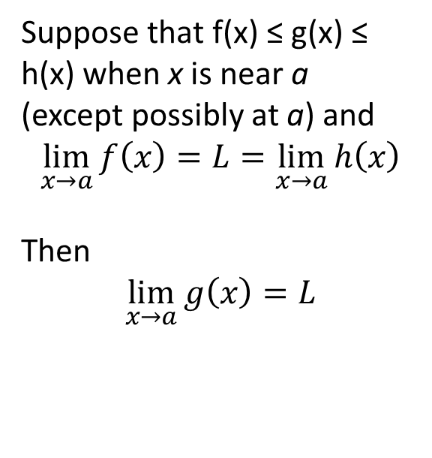
The Squeeze Theorem
Suppose that f(x) ≤ g(x) ≤ h(x) when x is near a
(except possibly at a) and
$$\lim_{x→a}{f\left(x\right)}=L=\lim_{x→a}{h\left(x\right)}$$
Then
$$\lim_{x→a}{g\left(x\right)}=L$$

Slide 29
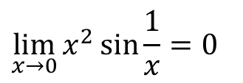
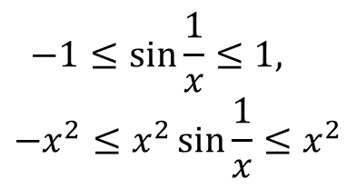
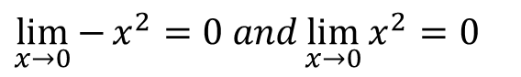
Example 8
1
2
Lets find
Remember -1 ≤ sin x ≤ 1 for every real number t, so that
$$−1≤\sin{\frac{1}{x}}≤1,$$
$$−x^{2}≤x^{2}\sin{\frac{1}{x}}≤x^{2}$$
We know that
4
3
$$\lim_{x→0}{x^{2}}\sin{\frac{1}{x}}=0$$
$$\lim_{x→0}{−}x^{2}=0 and\lim_{x→0}{x^{2}}=0$$

Slide 30
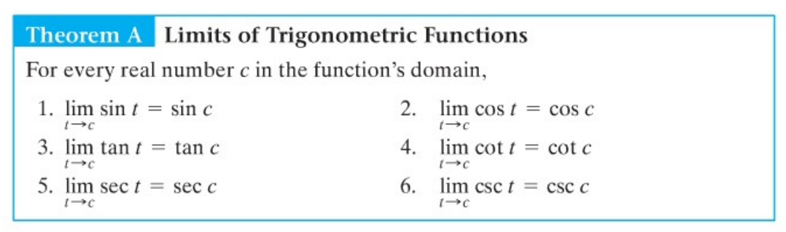
Limits Trigonometric

Slide 31
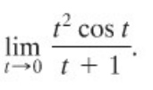
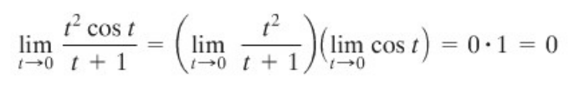
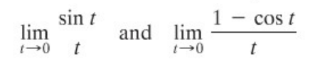
Example
Find
Solution
Two Important Limits that we cannot evaluate by substitution are :

Slide 32
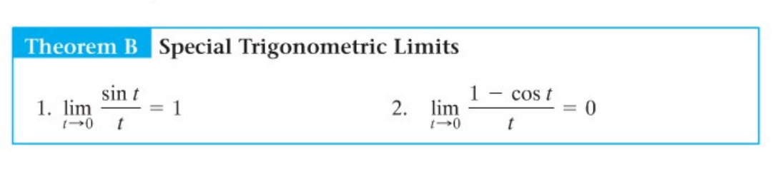
Limits Trigonometric

Slide 33
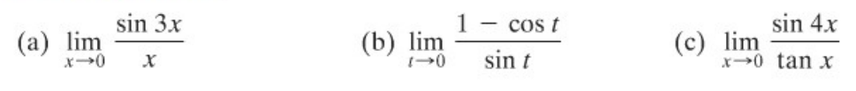
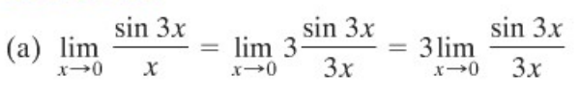
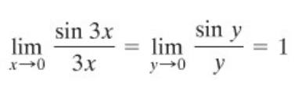
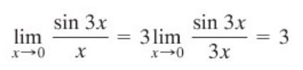
Example
Find
Solution

Slide 34
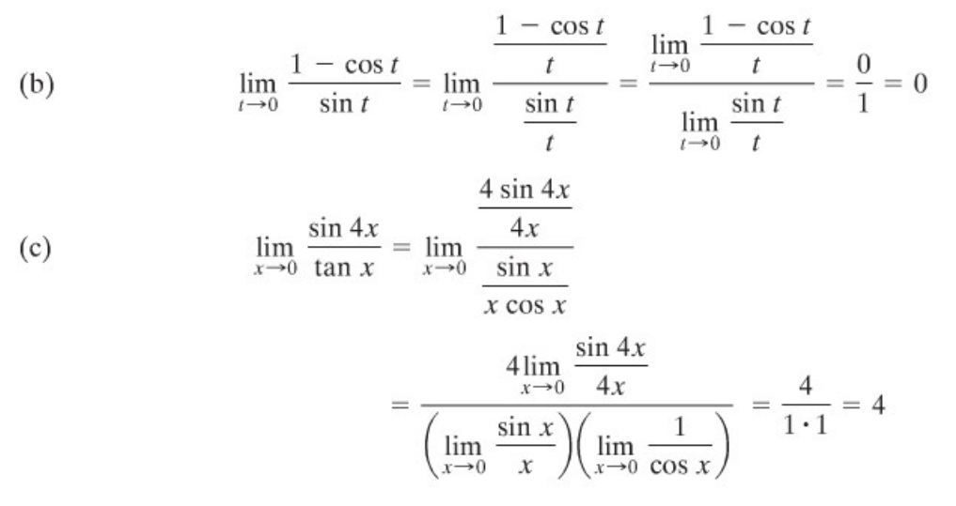
Example

Slide 35
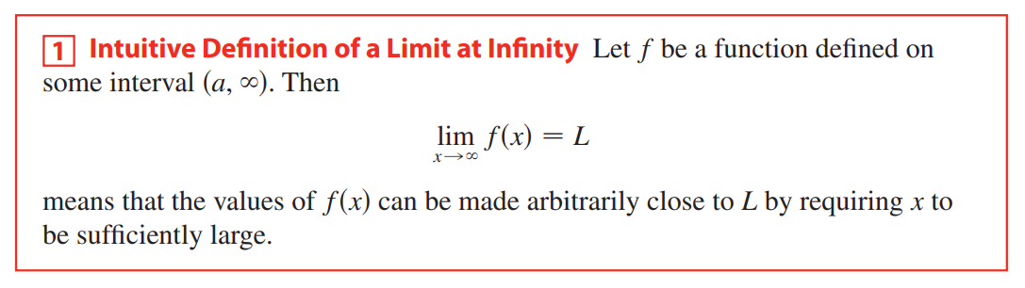


Limit at Infinity

Slide 36


Limit at Infinity

Slide 37


Example
Find
Solution

Slide 38

Latihan
1.
2.
3.
4.
5.
6.

Slide 39


Continuity at a Number
Definition
$$\lim_{x→a}{f\left(x\right)}=f(a)$$
A function f is continuous at a number a if
Notice that Definition implicitly requires three things if f is continuous at a:
f(a) is defined (that is, a is in the domain of f )
2. $\lim_{x→a}{f\left(x\right)}$ exists
3. $\lim_{x→a}{f\left(x\right)}=f(a)$

Slide 40

The Precise Definition of a Limit
Let f be a function defined on some open interval that contains the number a, except possibly at a itself. Then we say that the limit of $f(x)$ as x approaches a is L, and we write
$$\lim_{x→a}{f\left(x\right)=L}$$
if for every number $ε>0$ there is a number $δ>0$ such that
If $0<\left|x−a\right|<δ$ then $\left|f\left(x\right)−L\right|<ε$

Slide 41




Example 9
Let $f\left(x\right)=\left\{\begin{matrix}\frac{x^{2}−x−2}{x−2},x≠2 \\ 1, x=2\end{matrix}\right.$
Here $f\left(2\right)=1$ is defined
$$\lim_{x→2}{\frac{x^{2}−x−2}{x−2}}=\lim_{x→2}\frac{(x−2)(x+1)}{x−2}=\lim_{x→2}{x+1}=3$$
$$\lim_{x→2}{f\left(x\right)}≠f(2)$$
So f is not continuous at 2.

Slide 42

Latihan
$f\left(x\right)= \left\{\begin{matrix} \frac{x^{2}−4}{x−2 }, x≠2 \\ 4, x=2\end{matrix}\right.$
$f\left(x\right)= \left\{ \begin{matrix}\frac{x^{2}−x}{x^{2}−21}, x≠1 \\ 1, x=1\end{matrix}\right.$

Slide 43

The Others Continuity
Definition
A function f is continuous from the right at a number a if
$$\lim_{x→a^{+}}{f\left(x\right)}=f(a)$$
and f is continuous from the left at a if
$$\lim_{x→a^{−}}{f\left(x\right)}=f(a)$$
Definition
A function f is continuous on an interval if it is continuous at every number in the interval. (If f is defined only on one side of an endpoint of the interval, we understand continuous at the endpoint to mean continuous from the right or continuous from the left.)

Slide 44





Properties of Continuous Functions
Theorem
Theorem
The following types of functions are continuous at every number in their domains:
If f and g are continuous at a and c is a constant, then the following functions are also continuous at a:
polynomials
$$f+g$$
$$f−g$$
rational functions
$$cf$$
root functions
trigonometric functions
$$fg$$
inverse trigonometric functions
$\frac{f}{g}$ if $g\left(a\right)≠0$
exponential functions
logarithmic functions

Slide 45





Example 10
Where is the function $f\left(x\right)=\frac{\ln{x}+\tan^{−1}{x}}{x^{2}−1}$ continuous?
$y=\ln{x}$ is continuous for $x>0$ and $y=\tan^{−1}{x}$ is continuous on real numbers.
$y=\ln{x}+\tan^{−1}{x}$ is continuous on $(0,∞)$
The denominator $y=x^{2}−1$ is is a polynomial, so it is continuous everywhere.
f is continuous at all positive number x except where
$$x^{2}−1=0↔x=±1$$
f is continuous on the intervals (0,1) and (1,$∞$)

Slide 46

The Intermediate Value Theorem
The Intermediate Value Theorem
Suppose that f is continuous on the closed interval [a, b] and let N be any number between f(a) and f(b), where f(a)$≠$ f(b). Then there exists a number c in (a, b) such that f(c) = N.

Slide 47

Example 11
Show that there is a solution of the equation $4x^{3}−6x^{2}+3x−2=0$ between 1 and 2.
Let $f\left(x\right)=4x^{3}−6x^{2}+3x−2$
We are looking for a solution of the given equation, that is, a number c between 1 and 2 such that f(c) = 0.
Therefore we take a = 1, b = 2, and N = 0 in The Indeterminate Value Theorem:
$$f\left(1\right)=4−6+3−2=−1<0$$
$$f\left(2\right)=32 −24+6−2=12>0$$
Thus f(1) < 0 < f (2); that is, N = 0 is a number between f (1) and f(2). The function f is continuous since it is a polynomial, so the Intermediate Value Theorem says there is a number c between 1 and 2 such that f(c)= 0. In other words, the equation $4x^{3}−6x^{2}+3x−2=0$ has at least one solution c in the interval (1,2)

Slide 48
Example 12: Evaluating Limits at Infinity

Slide 49
Example 13: Evaluating Limits at Infinity

Slide 50
Thank You

